Slide 1
S&P 500 Companies Analysis
Medha Mallampati SHP Rutgers University BINF5900: Data Science Programming (Advanced Python) Instructor: Dr. Riddhi Vyas

Slide 2
Objectives
Utilize advanced python tools and libraries (Numpy and Matplotlib) to analyze S&P 500 Companies data.
Data download, cleaning, and preparation.
Update missing data elements through user input.
Generate various analytical reports to show:
Companies by Sector
Top Ten (10) Dividend Yield Companies by Sector
Top Five (5) Companies with the lowest 52 Week Price Change along with corresponding P/E Ratio.
Generate data visualization charts for the above reports.

Slide 3
About Data
The data is a list of companies in S&P (Standard’s and Poor) 500 index. The list includes the 500 largest companies in the United States, tracked and traded in the stock market.
The dataset was taken from ‘datahub’ in a .csv file format.
Due to certain string fields within the dataset containing commas, this dataset was saved as a tab delimited text file to ensure the correct data values.
This dataset is dated back to 2 years, so all information is related to S&P 500 data from the year 2021.

Slide 4
Dataset Fields:
Field Name | Description
Symbol | Series of letters identifying the company. Also known as ticker symbol.
Name | The company name in S&P 500.
Sector | The category a company is grouped into. Can also be understood as industry a company is grouped into.
Price | The trading share value of the company.
Price/Earnings | Price to Earnings ratio. This tells investors how much they can expect to invest to receive a dollar of the company’s earnings. Measures the security of the stock investment.
Dividend Yield | The total dividends (sum of money paid regularly by a company to shareholders out of its profits/reserves) earned in a year divided by the stock price. This tells investors how much they can earn per year for every dollar invested.
Earnings/Share | Indicates profitability of the company. Investors will look for a higher value since this means the company has higher profits compared to the share price.
52 Week Low | Shows the highest/lowest price when the stock had been traded during the 52 week time period. These values tells investors how volatile the stock price is during the 52 week period.
52 Week High
Market Cap | Measures the worth of the company in the market.
EBITDA | Measures the company’s overall performance in the market.
Price/Sales | Compares the company’s stock price to revenues.
Price/Book | Measures the market’s value of a company compared to the book value.
SEC Filings | URL containing information in relation to the company.

Slide 5
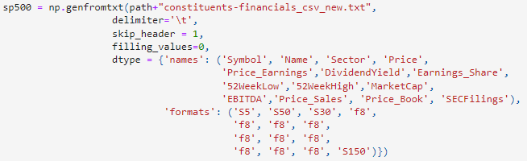
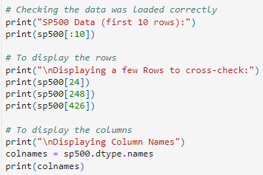
Selecting and Creating Dataset
Created a numpy array with fixed datatypes and added data from tab delimited text file

Slide 6
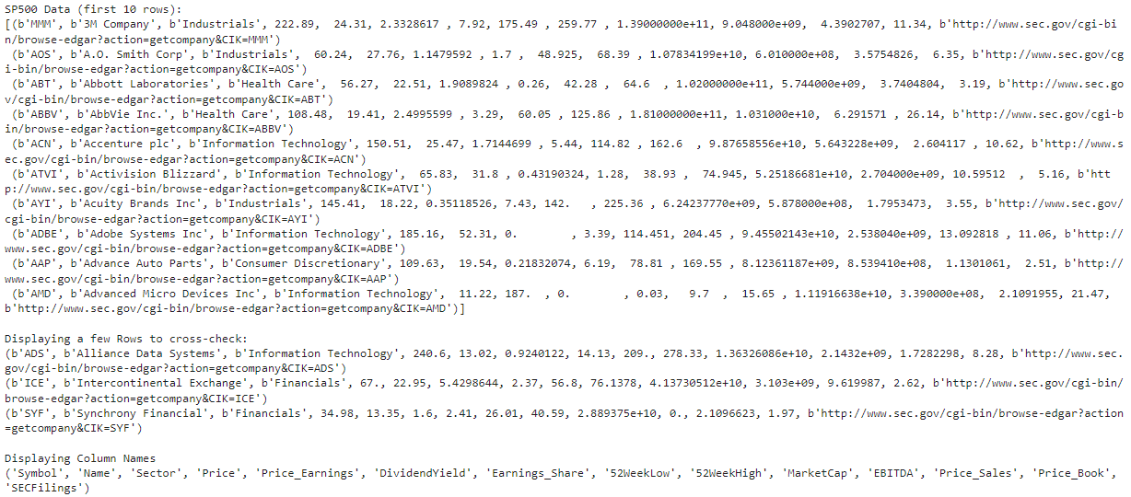

Slide 7
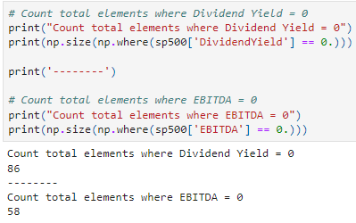
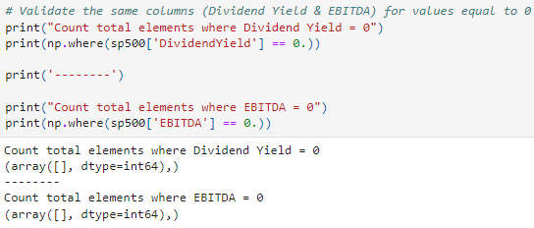
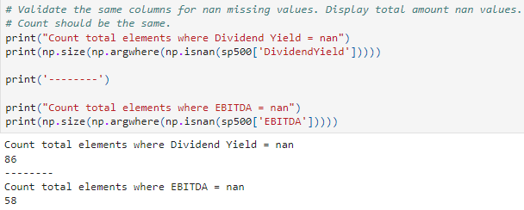
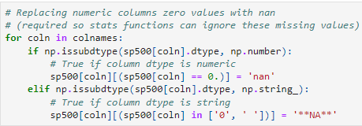
Cleaning Dataset
Replaced numeric columns where value is 0 with sentinel value ‘nan’ so statistical calculations can ignore these values.

Slide 8
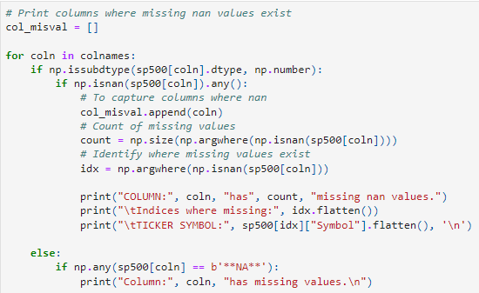
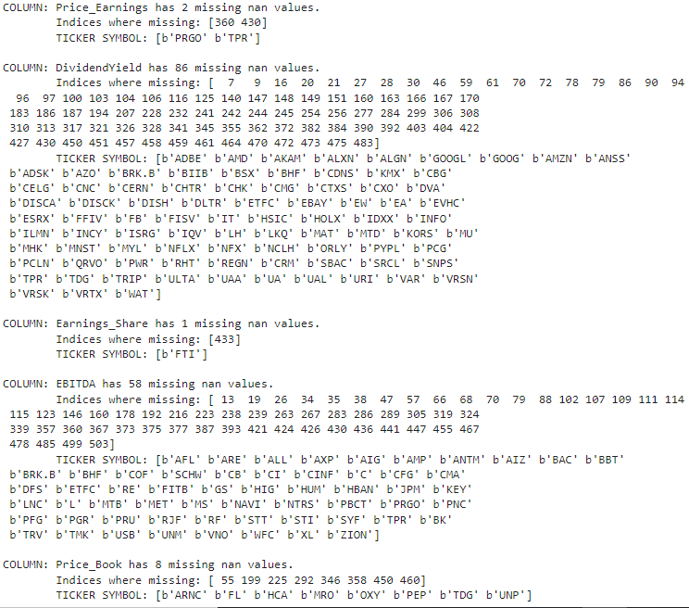
Viewing the columns where ‘nan’ exists

Slide 9
User Input
User will be able to replace sentinel values ‘nan’ with a new value if it exists.
For those companies with missing Dividend Yield values, could not find information on the internet. Therefore, these values will remain as sentinel value ‘nan’.

Slide 10
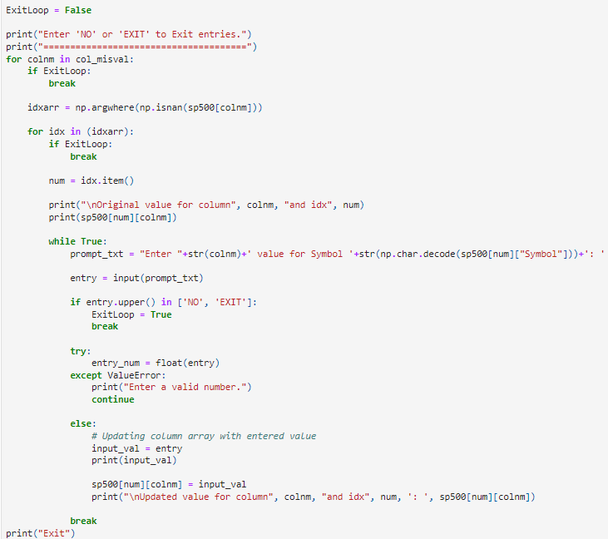
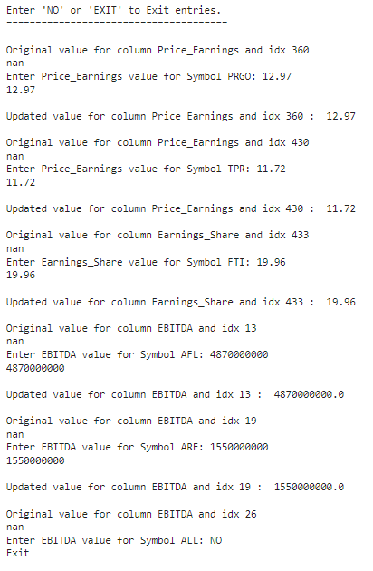

Slide 11
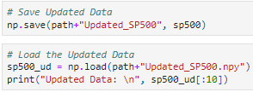
Updated Data
This data is once again cleaned where values with 0 are replaced with sentinel value ‘nan’.
The new updated data is then saved to view and load for future reports.

Slide 12
Report 1
Statistical data of Companies by Sector.
Report will show for each sector the total companies count, the maximum, minimum, and average market cap, and lastly the average EBITDA.
Created ‘report_1’ with fixed datatypes for the necessary columns mentioned above.
The report is then saved and later sorted for the data visualization.

Slide 13
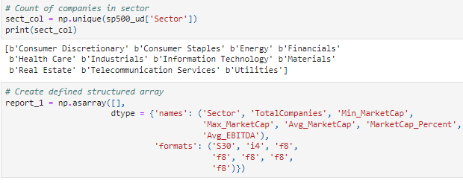
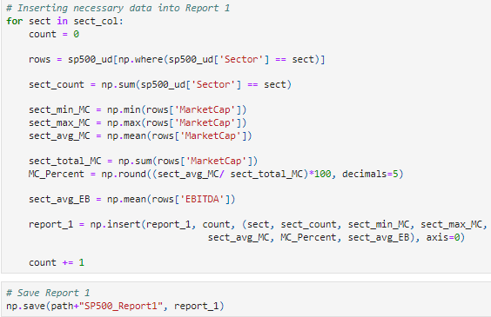
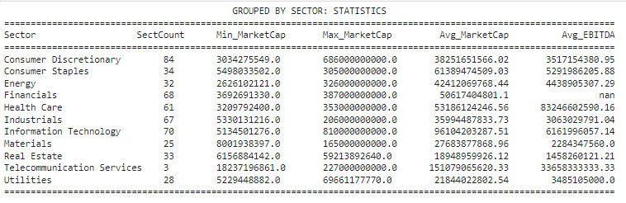

Slide 14
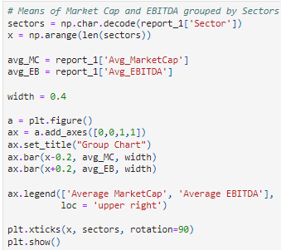
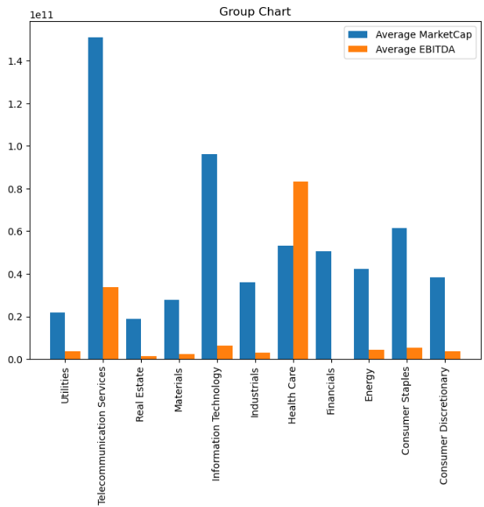

Slide 15
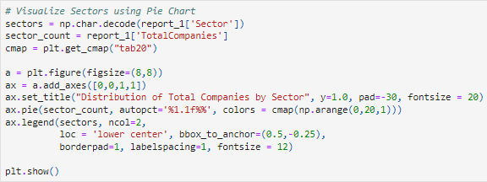
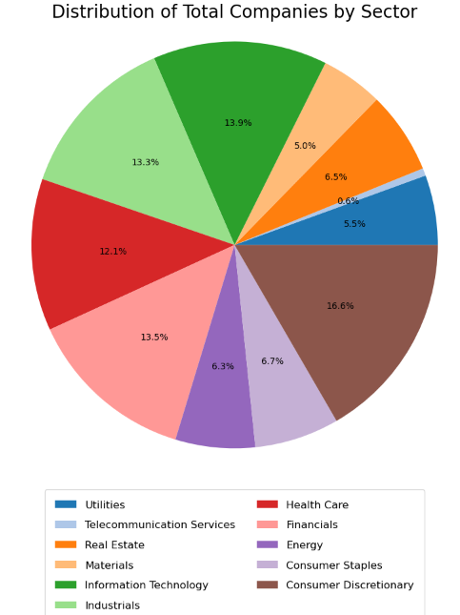

Slide 16
Report 2
Top Ten (10) Dividend Yield Companies.
Report will show the top 10 companies symbol, name, associated sector, price, price earnings, and dividend yield.
Created ‘report_2’ with fixed datatypes for the necessary columns mentioned above.
Since we only want the top 10 dividend yield companies, I sorted the data ‘sp500_ud’ by column ‘DividendYield’ in descending order and conditioned to not include nan (missing) values. The first 10 are then chosen.
The report 2 is then saved and the data visualization chart is generated.

Slide 17
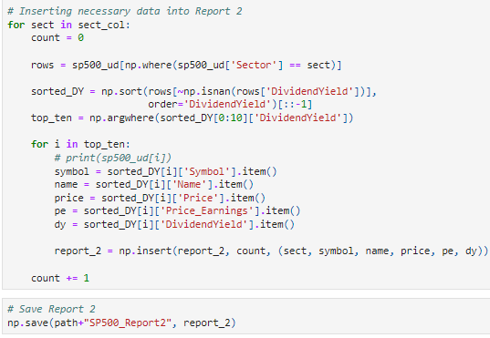
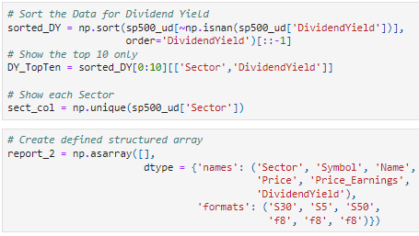

Slide 18
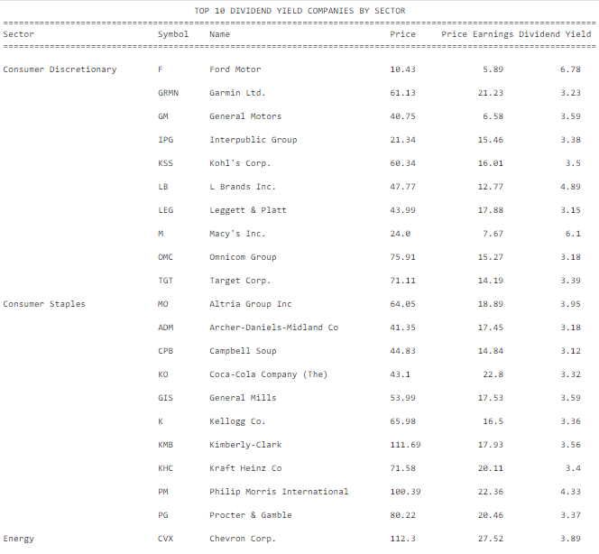
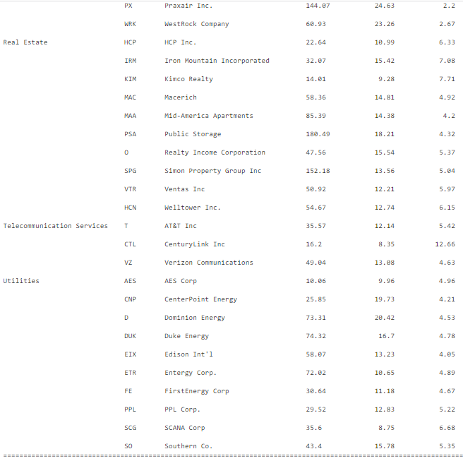

Slide 19
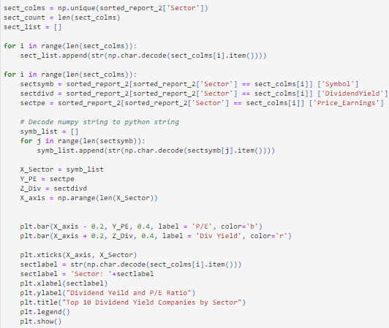

Slide 20
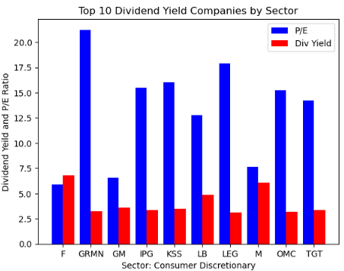
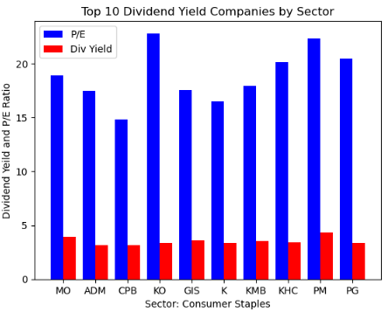
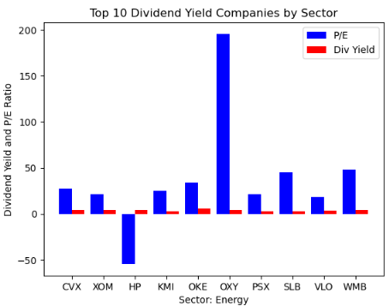
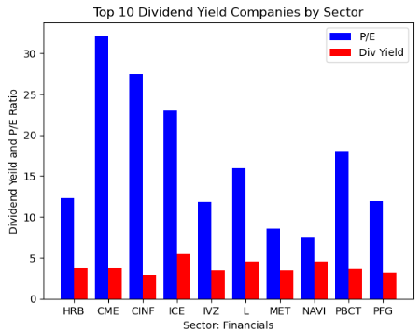
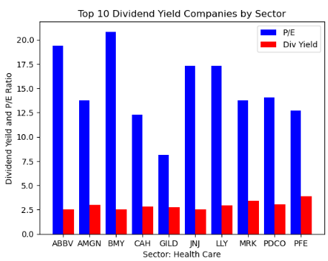
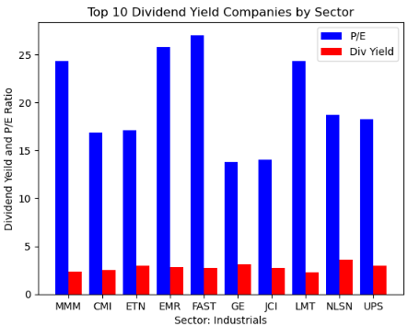
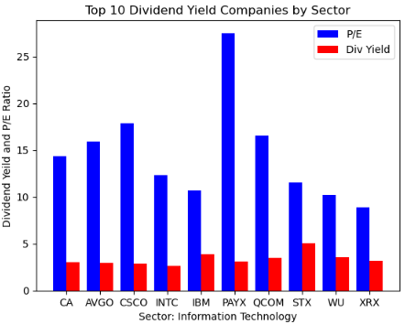
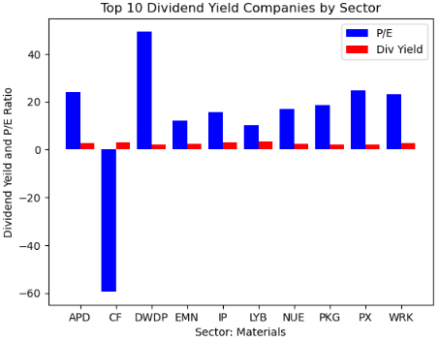
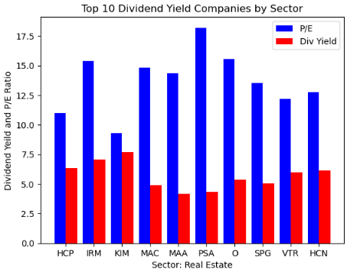
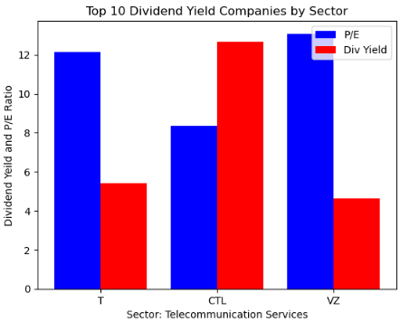
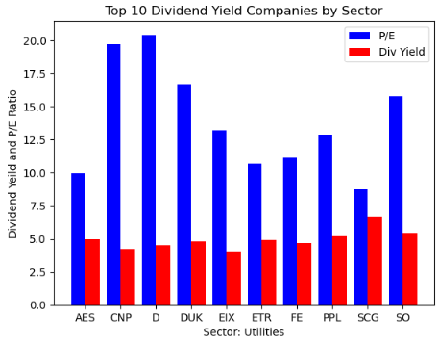

Slide 21
Report 3
Top Five (5) Companies with the lowest 52 Week Price Change with corresponding Price/Earnings.
Report will show for each sector: sector, symbol, name, price, price earnings, 52 week high, 52 week low, 52 week range (max - min).
Created ‘report_3’ with fixed datatypes for the necessary columns mentioned above.
The report 3 is then saved and data visualization charts are generated.

Slide 22
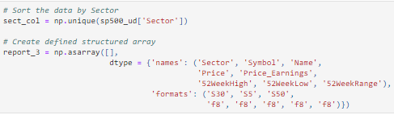
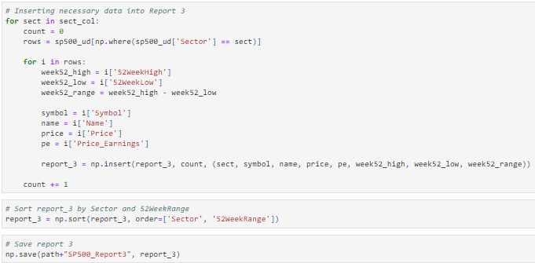

Slide 23
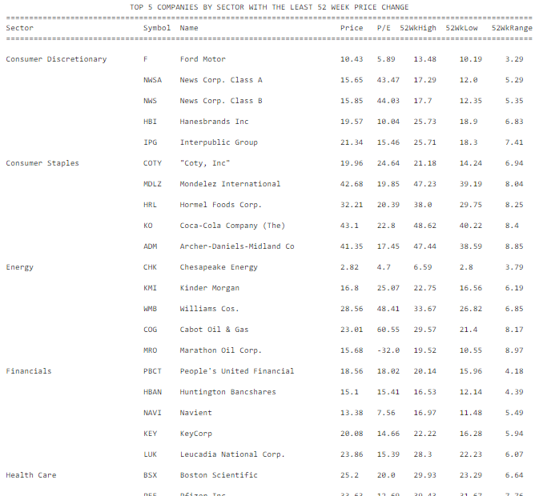
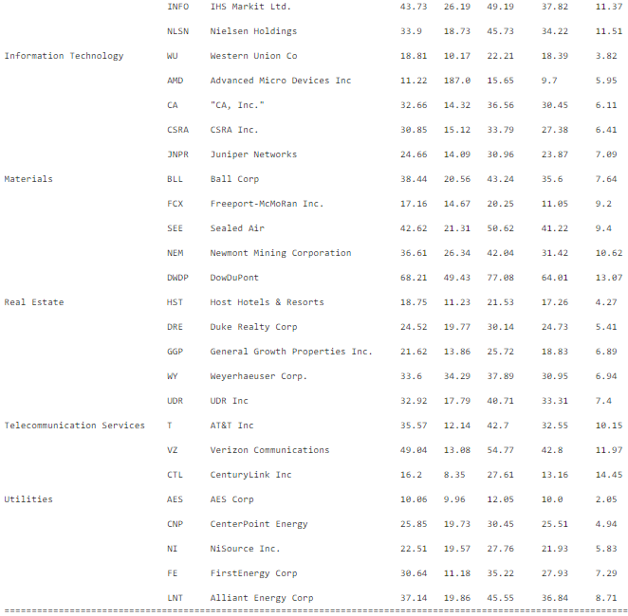

Slide 24
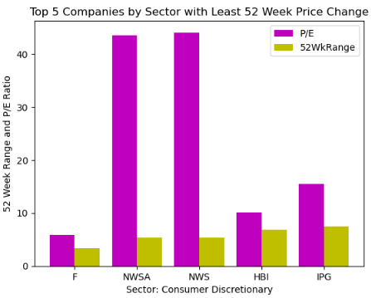
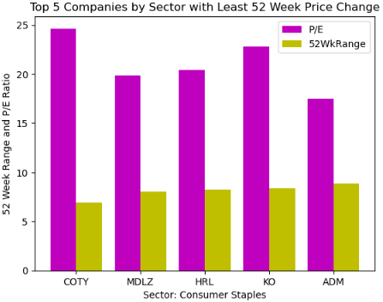
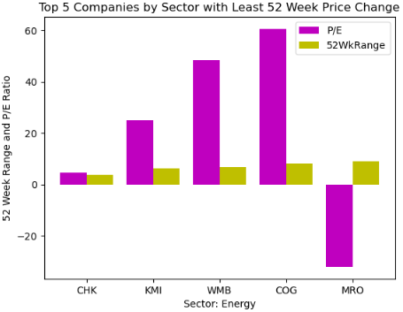
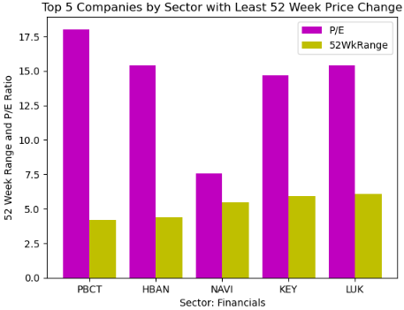
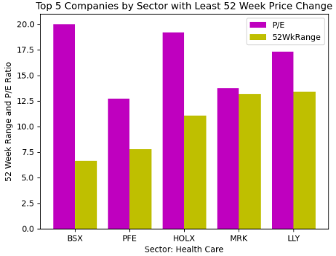
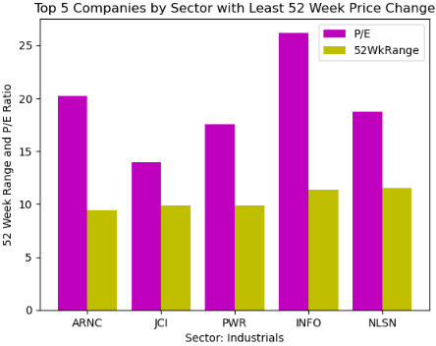
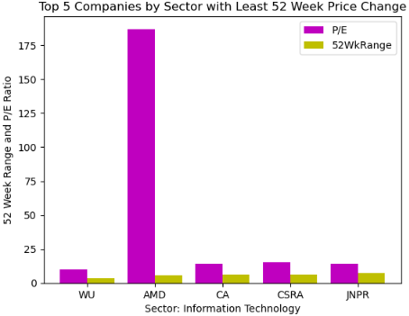
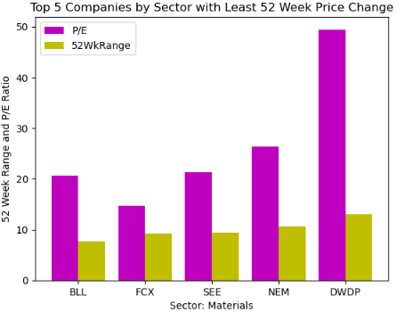
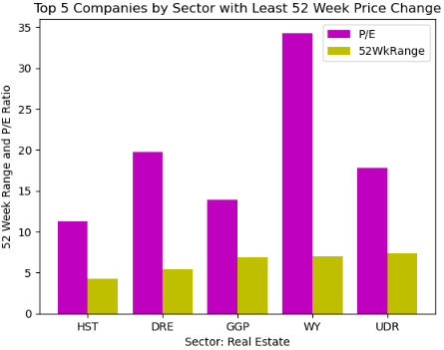
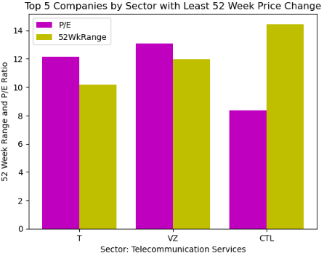
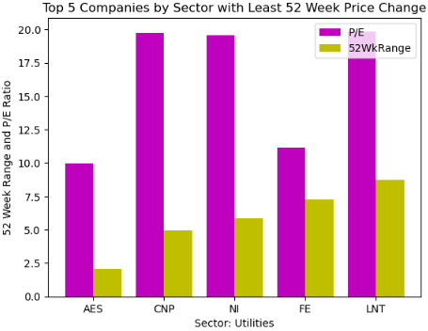

Slide 25
Conclusion
Report 1 analyzed each sector about financial strength/Market Cap, along with overall financial performance/EBITDA. The Pie Chart will show companies within each sector.
Report 2 analyzed the top ten dividend yield companies along with the P/E ratio within each sector in order to get the best returns on investment. Sector wise group charts will provide clear visuals to pick the best dividend yield companies.
Report 3 analyzed the top five most stable companies within each sector along with corresponding P/E ratio. Sector wise group charts will provide clear visuals to pick the right companies for investment.

Slide 26
References
1. Datopian. S&P 500 Companies with Financial Information. DataHub. https://datahub.io/core/s-and-p-500-companies-financials#readme
2. McFarlane G. The S&P 500: The Index You Need To Know. Investopedia. Published July 20, 2022. https://www.investopedia.com/articles/investing/090414/sp-500-index-you-need-know.asp
3. LANGAGER C. Industry vs. Sector: What’s the Difference? Investopedia. Published January 27, 2022. https://www.investopedia.com/ask/answers/05/industrysector.asp
4. Hayes A. Price-to-Earnings Ratio – P/E Ratio. Investopedia. Published July 14, 2022. https://www.investopedia.com/terms/p/price-earningsratio.asp#:~:text=In%20essence%2C%20the%20price%2Dto
5. Fernando J. Dividend Yield. Investopedia. Published August 30, 2022. https://www.investopedia.com/terms/d/dividendyield.asp
6. Fernando J. Understanding Earnings Per Share – EPS. Investopedia. Published August 23, 2022. https://www.investopedia.com/terms/e/eps.asp
7. Chen J. 52-Week High/Low Definition. Investopedia. https://www.investopedia.com/terms/1/52weekhighlow.asp
8. Maverick JB. What Is Considered a Healthy EV/EBITDA ? Investopedia. Published 2020. https://www.investopedia.com/ask/answers/072715/what-considered-healthy-evebitda.asp
9. Hargrave M. What Does the Price-to-Sales (P/S) Ratio Reveal? Investopedia. Published 2019. https://www.investopedia.com/terms/p/price-to-salesratio.asp
10. Hayes A. What the Price-to-Book Ratio (P/B Ratio) Tells Us. Investopedia. Published 2019. https://www.investopedia.com/terms/p/price-to-bookratio.asp ‌
‌
‌

